Slide 1


Making Presentations That Stick
Data Engineering Project
Building a Real-Time Retail Transaction Pipeline Using
Kafka, Spark, and MongoDB
A guide by Chip Heath & Dan Heath
Data Engineering Consultant: Samuel Emokpae

Slide 2

Business Overview
Dulex Mall. operates in the fast-paced retail industry, where real-time
access to transactional insights is critical for optimizing operations, inventory management, and customer engagement. Our success is fueled by the ability to swiftly analyze sales patterns, detect demand fluctuations, and tailor customer experiences across our omnichannel platforms.
However, we currently face a major challenge with fragmented and delayed data processing workflows, which limits our ability to react to live sales trends and inventory changes.
To address this, we are launching a data engineering initiative to build a seamless real-time retail transaction streaming pipeline using Kafka for data ingestion, Apache Spark for real-time processing, and MongoDB for scalable storage of transactional records.
Additionally, we are integrating Docker and Docker Compose to streamline the deployment and management of our infrastructure, ensuring scalability, reliability, and faster collaboration across development teams.
Real-Time Retail Transaction Pipeline

Slide 3


Tech Stack
GitHub: Manages version control and collaboration for code, documentation, and project tracking, ensuring that all team members are aligned and can contribute effectively.
Spark: Utilized for processing large datasets in real-time, allowing for fast and scalable data transformations and analytics.
Python: Used for scripting data extraction, cleaning, and transformation processes, enabling efficient handling of data from various sources.
Kafka: Serves as the messaging system for building a real-time streaming data pipeline, facilitating the ingestion of data from Reddit.
MongoDB: A NoSQL database that stores unstructured data, providing flexibility in managing diverse data formats during the ETL process.
Draw.io: Utilized to create diagrams that outline data flow, architecture, and ETL process design, providing a visual representation of the system for better understanding and communication
Docker: Leveraged to containerize applications and services, ensuring consistent environments across development, testing, and production.
Tools
Python,
Spark,
Kafka,
Docker,
GitHub,
Mongodb
Real-Time Retail Transaction Pipeline

Slide 4
Business Problems
Inefficient Data Processing
Limited Real-Time Analysis
Disparate Datasets
Inability to Scale
Slow and cumbersome data processing can lead to delays in generating insights, resulting in missed opportunities to engage with consumers effectively.
The inability to analyze data in real-time restricts the agency's capacity to respond quickly to market changes or consumer purchase. This lag can result in lost leads and diminished competitive advantage
When data is stored in silos or is not integrated, it becomes challenging to obtain a holistic view of consumer behaviour. This fragmentation can lead to inconsistent messaging and ineffective marketing campaigns
As the volume of data grows, the current fragmented system may struggle to keep up, making it difficult for the agency to scale its operations.
Real-Time Retail Transaction Pipeline

Slide 5

Project Objectives
Real-Time Data Ingestion: To develop a robust pipeline that continuously collects and streams
data from API using Kafka, ensuring minimal latency in data availability.
Data Processing and Analysis: To implement Apache Spark Streaming for real-time data
processing tasks, including text preprocessing, language detection, and sentiment analysis, using
machine learning models.
Data Storage and Security: To securely store processed data in a MongoDB NoSQL database,
ensuring data integrity and accessibility for future analysis.
Insight Generation: To enable organizations to derive actionable insights from real-time data,
facilitating informed decision-making in areas such as marketing, product development, and
customer engagement.
Real-Time Retail Transaction Pipeline

Slide 6
Project Enhancement
To enhance project delivery and ensure a scalable, maintainable architecture, the following
components will be integrated into the data engineering workflow:
API Integration: A dedicated RESTful API will serve as the primary data source for streaming structured retail transaction data. This API delivers JSON-formatted records in real time, including transaction details such as store, customer, product, and payment information, which will feed directly into the Kafka ingestion layer.
API URI: Stream: https://retails-api.amdari.io/stream: API Endpoint for data stream
GitHub: GitHub will be used for version control and collaborative development. It enables seamless coordination among team members, ensuring codebase integrity, transparent change tracking, and efficient issue management through pull requests and code reviews.
Docker: Docker will be used to containerize all core services including Kafka, Apache Spark, MongoDB, and the API client.
This ensures consistent runtime environments across development and deployment stages, enhances portability, and simplifies service orchestration using Docker Compose. It also streamlines onboarding and supports scalable, modular deployment of the entire data pipeline.
Real-Time Retail Transaction Pipeline

Slide 7
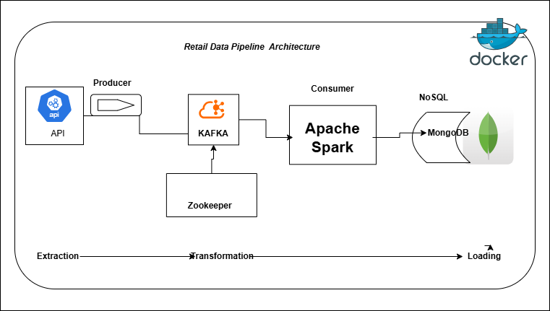
Retail-Data Pipeline Architecture Design
Real-Time Retail Transaction Pipeline

Slide 8
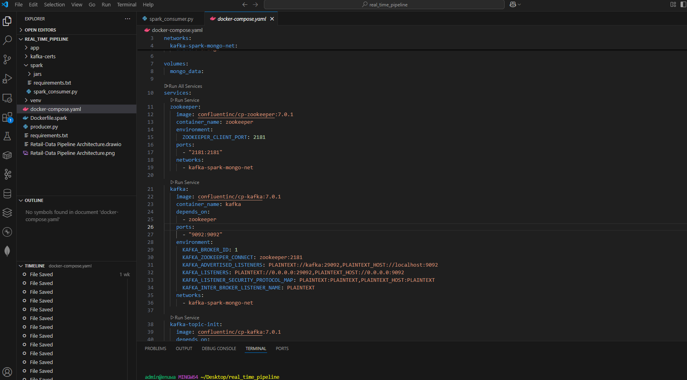
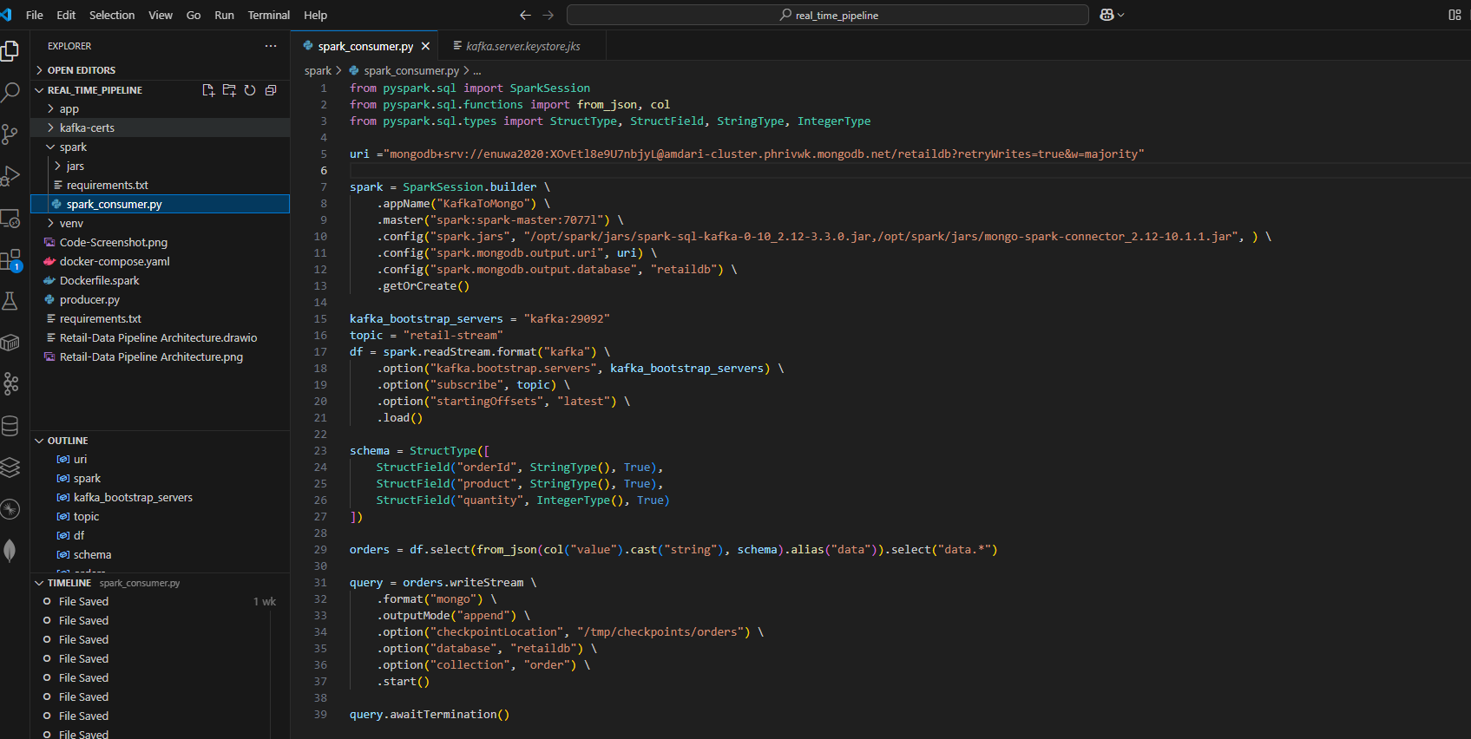
Quick Code Walk-through
Real-Time Retail Transaction Pipeline

Slide 9
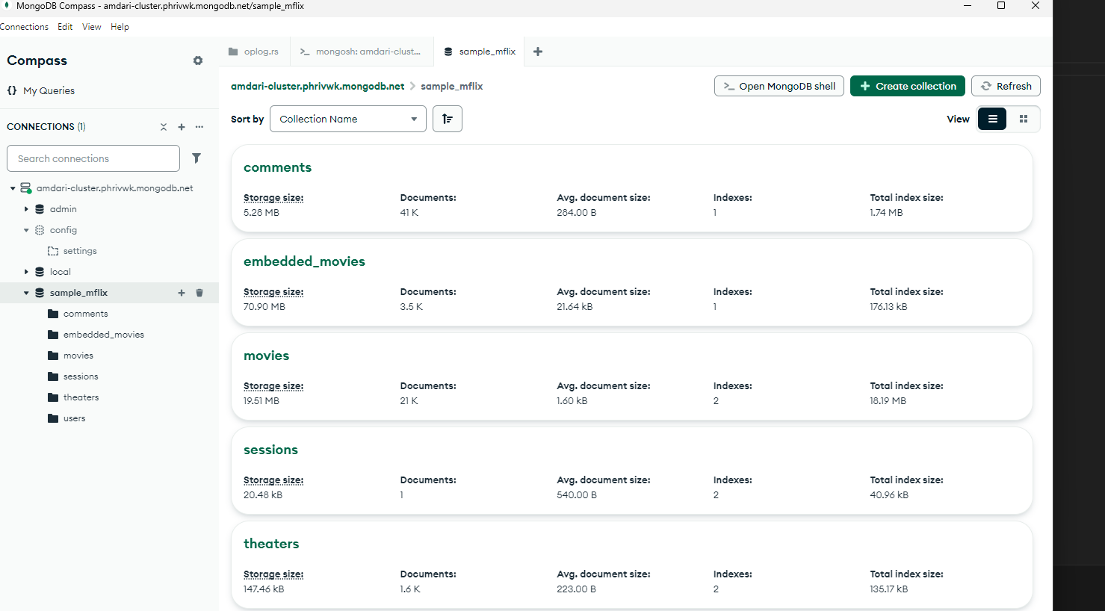
Transactions table in Mongodb
Real-Time Retail Transaction Pipeline

Slide 10

Conclusion
Project Benefits To the Company
Real-Time Data Ingestion: Developed a robust pipeline that continuously collects and streams data from API using Kafka, ensuring minimal latency in data availability.
Data Processing and Analysis: Implemented Apache Spark Streaming for real-time data processing tasks, including text preprocessing, language detection, and sentiment analysis, using machine learning models.
Data Storage and Security: Securely stored processed data in a MongoDB NoSQL database, ensuring data integrity and accessibility for future analysis.
Insight Generation: Enabled organizational business-drivers to derive actionable insights from real-time data, facilitating informed decision-making in areas such as marketing, product development, and customer engagement.
Real-Time Retail Transaction Pipeline

Slide 11

Then, Marcos discovered Google Translate
Real-Time Retail Transaction Pipeline

Slide 12
Good luck!
We hope you’ll use these tips to go out and deliver a memorable pitch for your product or service!
For more (free) presentation tips relevant to other types of messages, go to heathbrothers.com/presentations
For more about making your ideas stick with others, check out our book!

